Slide 1
Frontend Development

Slide 2

https://developer.mozilla.org

Slide 3
Elements that we will learn today:
ul (Unordered List element)
ol (Ordered List element)
li (list items)
Inspect element / View source / DOM
Nested lists

Slide 4
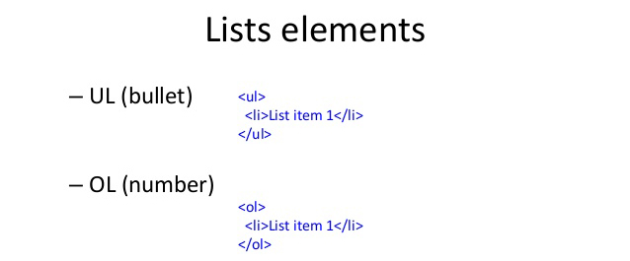

Slide 5

Inspect element / View source / DOM

Slide 6
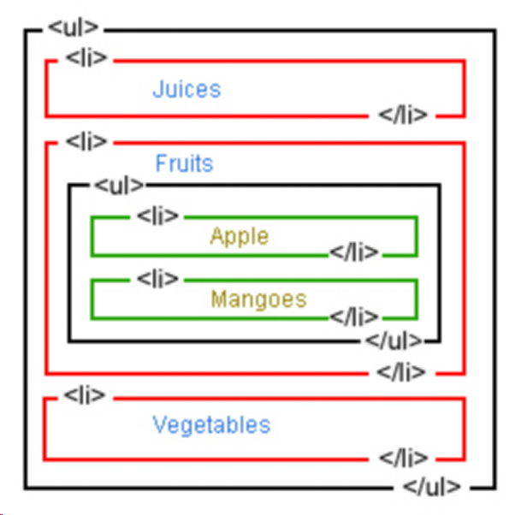
Nested List

Slide 7

Assignment
3 Countries, 3 provinces/states per country, 3 cities per province/state nested list

Slide 8
References
https://developer.mozilla.org/en-US/docs/Web/HTML/Element/ul
https://developer.mozilla.org/en-US/docs/Web/HTML/Element/ol
https://developer.mozilla.org/en-US/docs/Web/HTML/Element/li
https://developer.mozilla.org/en-US/docs/Tools/Page_Inspector/How_to/Examine_and_edit_HTML
https://developer.mozilla.org/en-US/docs/Tools/View_source

Slide 9


